Slide 1


WELCOME

Slide 2
TEAM LEADER : D. AMISHA
TEAM MEMBERS : P. BEMINA SHAN STAPHY
M. HEPHZIPHA GRACELIN
P. REDLIN REEJU
K. BENOLA

Slide 3
UNEARTHING THE ENVIRONMENTAL IMPACT OF HUMAN ACTIVITY A GLOBAL CO2 EMISSION ANALYSIS

Slide 4
PROBLEM:
A comprehensive and thorough analysis is necessary to study the CO2 emission mitigation measures in the building sector and global. The increasing average atmospheric temperature led to global warming, which drives a set of changes to the Earth’s climate and weather systems.

Slide 5
SOLUTION:
A strategic method for solving the problems for CO2 emission prevailing in the environment.

Slide 6
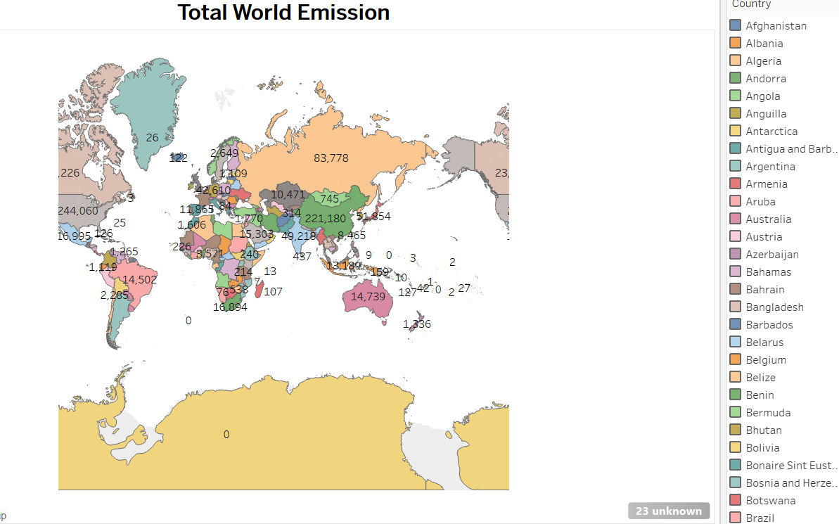
SHEETS

Slide 7
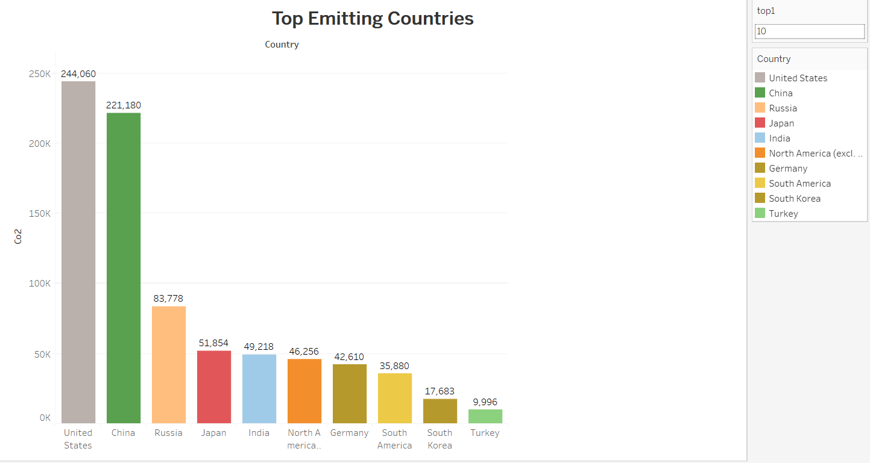

Slide 8
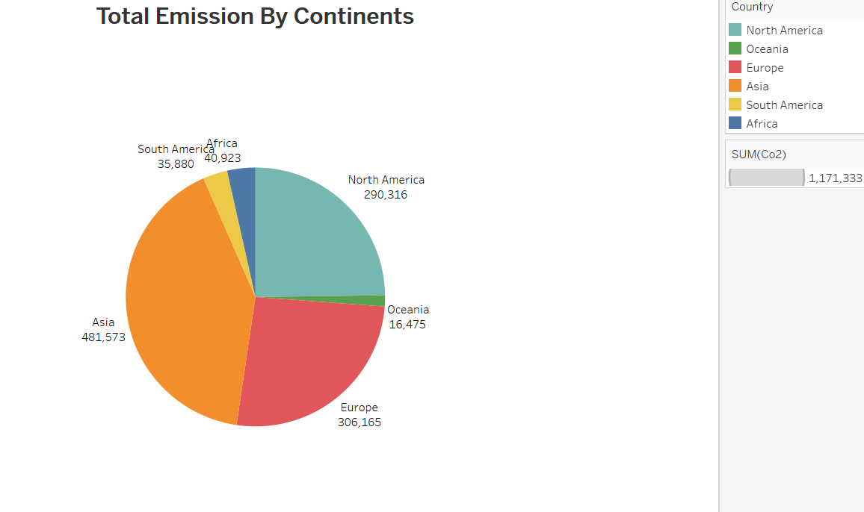

Slide 9
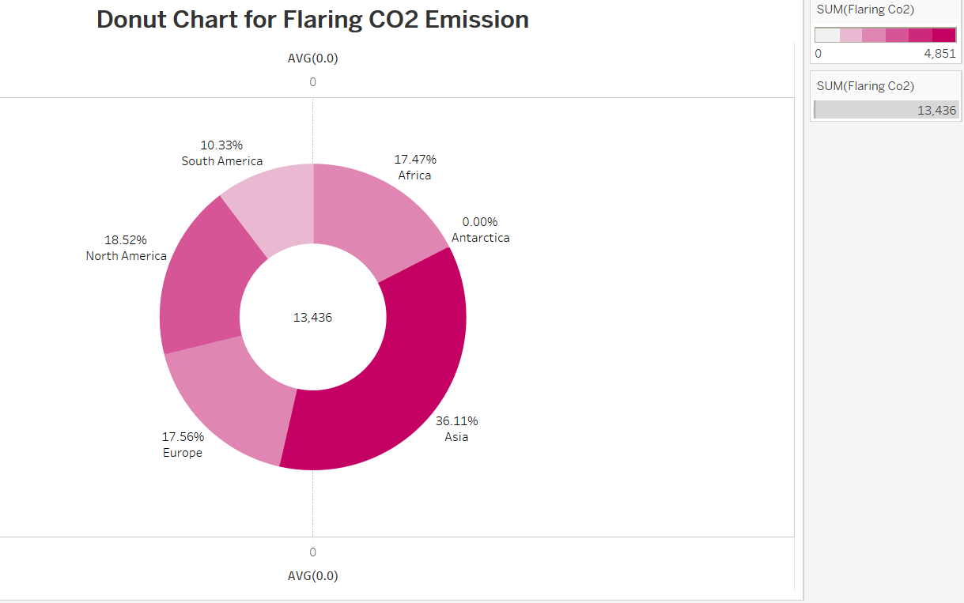

Slide 10
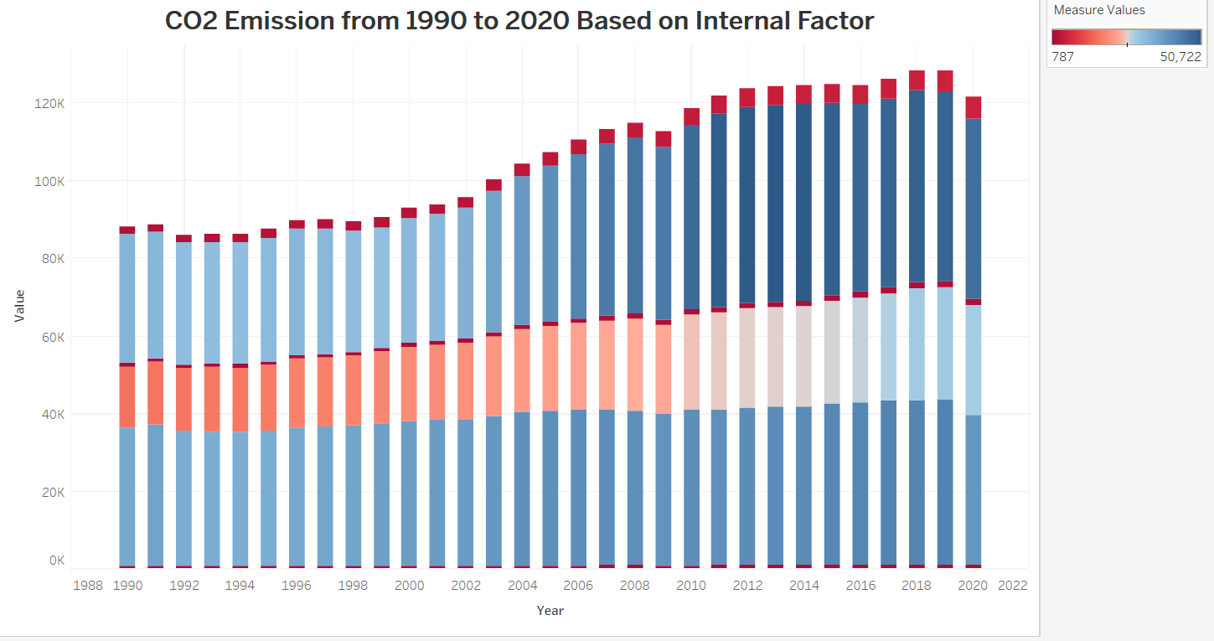

Slide 11
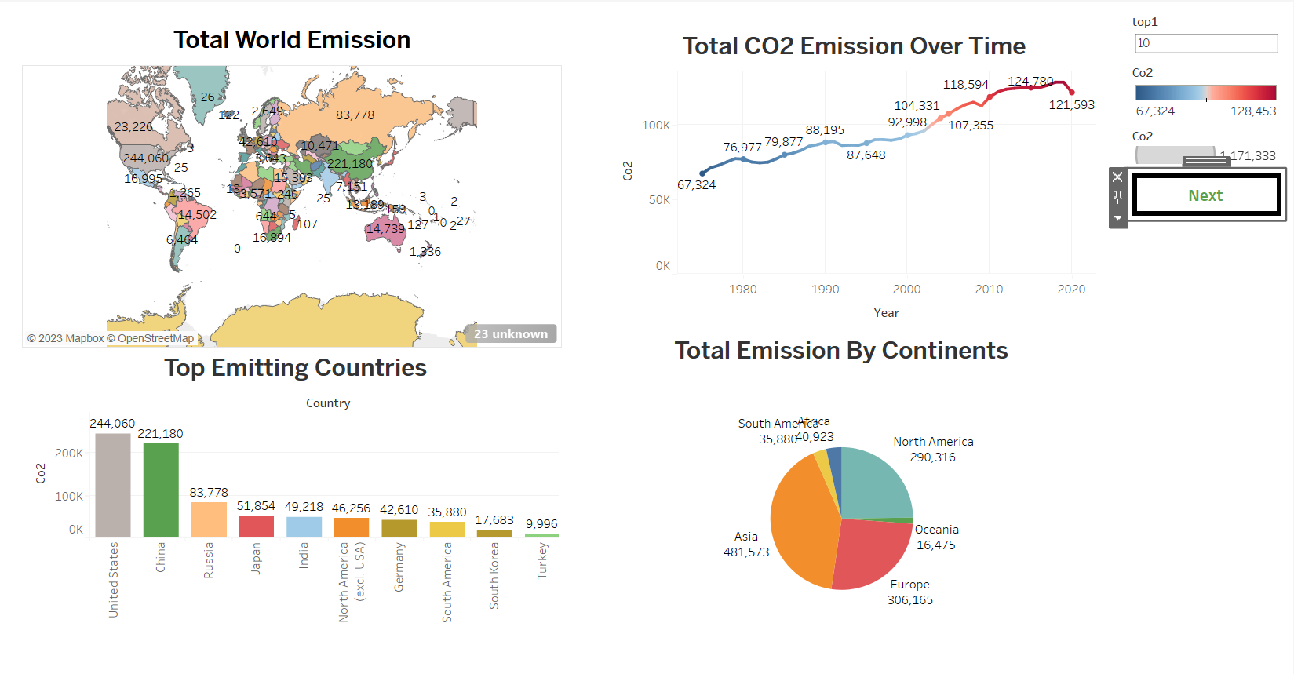
DASHBOARD
DASHBOARD

Slide 12
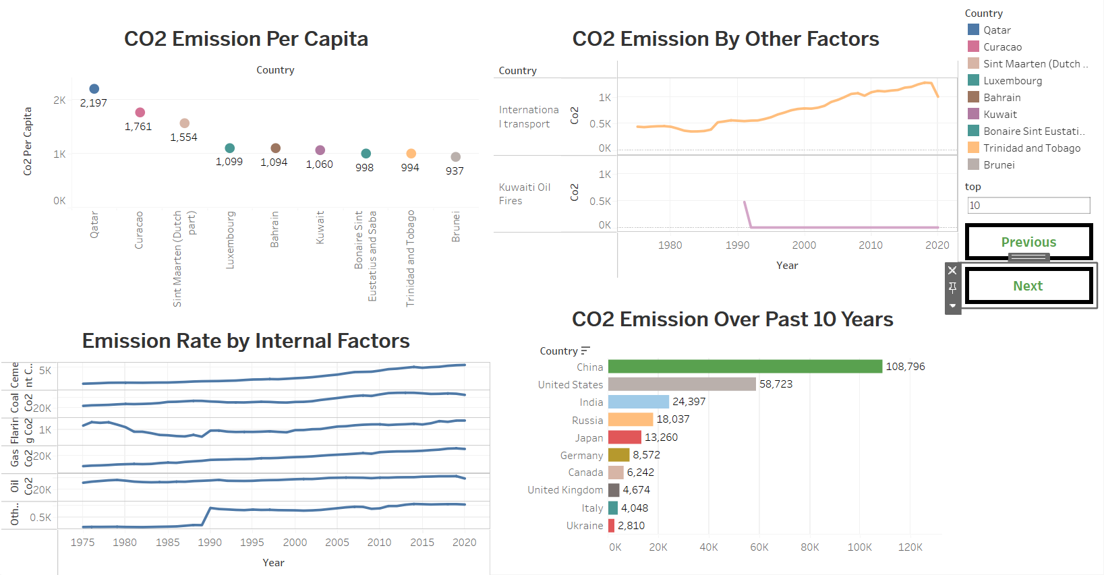

Slide 13
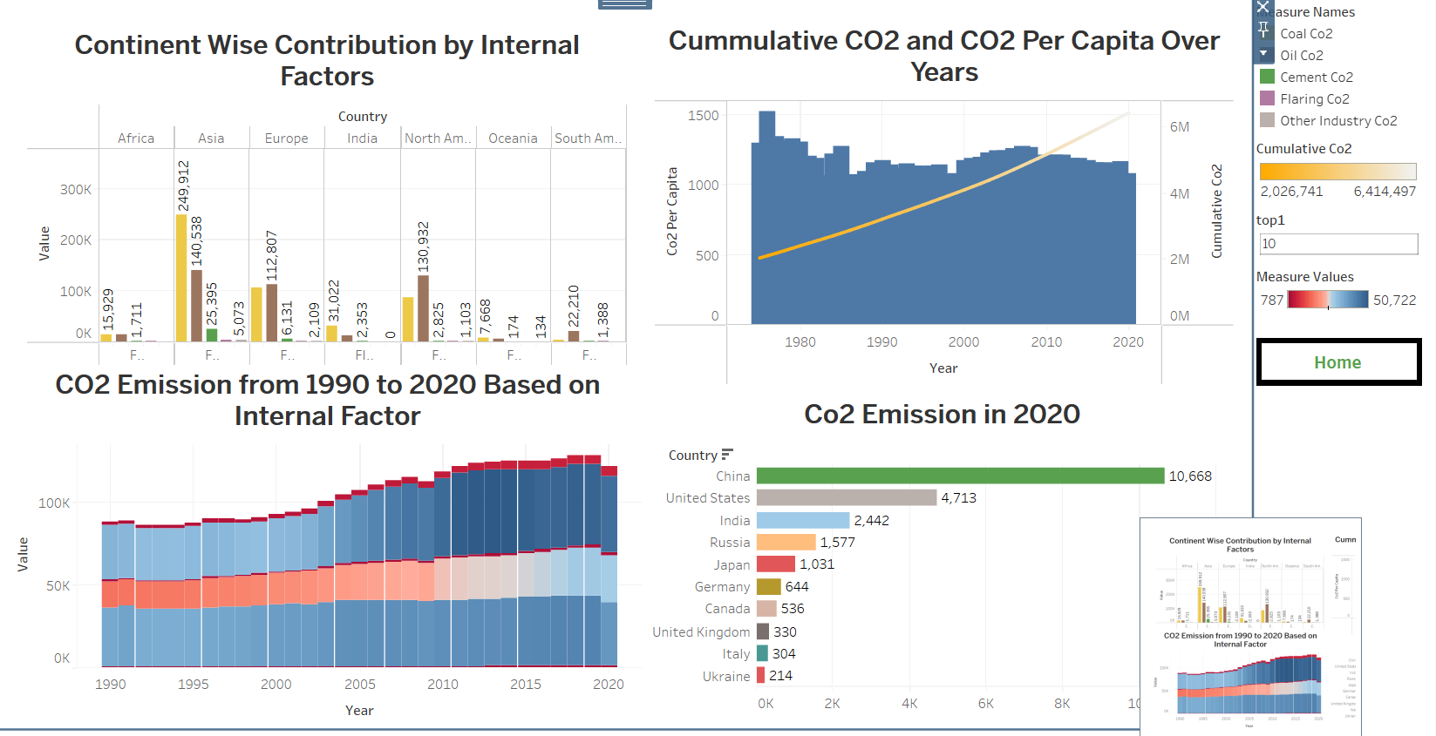

Slide 14
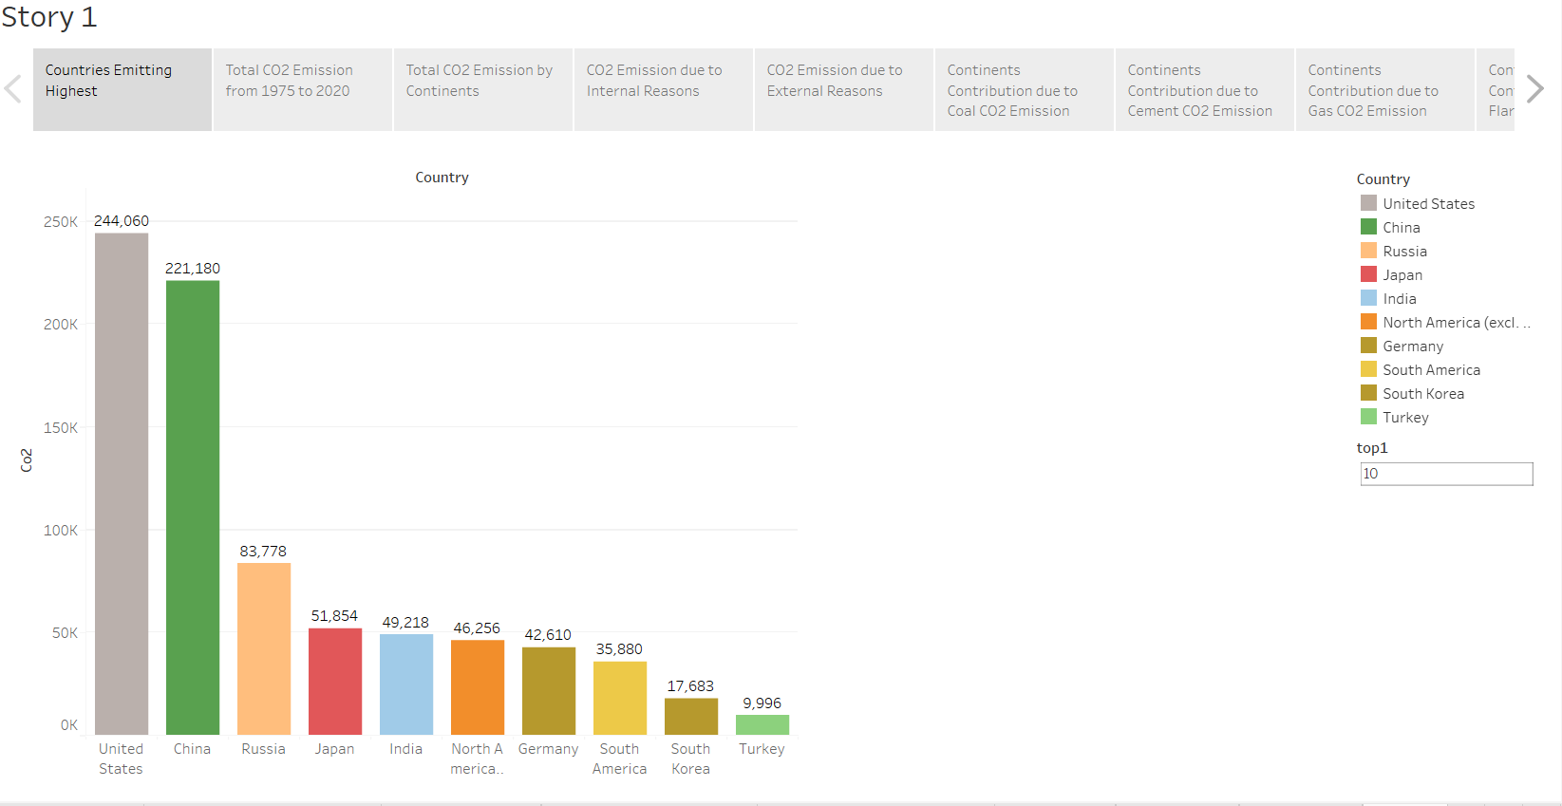
STORY

Slide 15
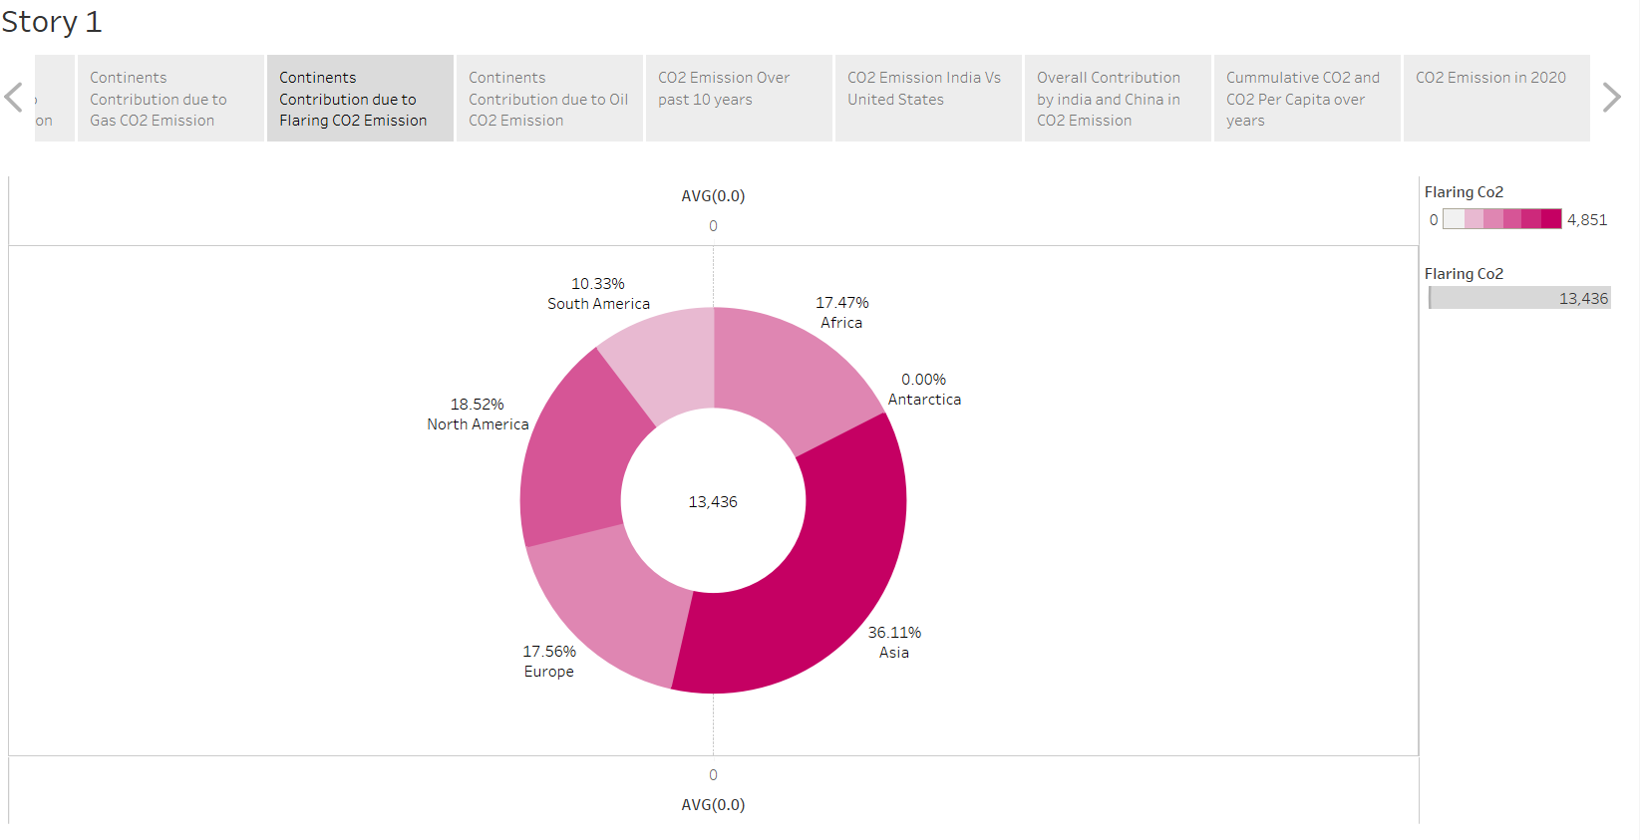

Slide 16

THANK YOU

